Slide 1
MATLAB Programming
Final Exam Two
Instructor: 黃世強 (Sai-Keung Wong)

Slide 2
Content
There are two problems. You must answer all of them.
You can create new files for functions.

Slide 3
About demo video and demo programs.
A demo video or a demo program may have bugs. They show or illustrate roughly the results. These results may not be exactly the same as the requirements. They are for your own reference. You must follow the instruction to finish your programs.

Slide 4
Program file name format
Write all your programs in a folder. The folder name is mat_exam_02_student_ID. For example, if your ID is 12345678, the folder name is mat_exam_02_12345678.
Zip the folder and upload it.
Write a program for each problem in one file.
The file name is ex02_X_yourStudentID.m, where X is the problem number.
For example, if your student ID is 12345678 and the problem number is 3, then the file name must be ex02_3_12345678.m.
You must not output all the intermediate results.
Output the results that are required only.

Slide 5
File content header
At the top of the file, write down your name, ID, email address, department, and date. If you do not do so, you receive a score of zero in the corresponding problem.
%%%%%%%%%%%%%%%%%%%%%%%%%%%
% Final Exam Number: …
% Problem number: …
% Student Name: …
% Student ID: …
% Email address: …
% Department:
% Date: ….
%%%%%%%%%%%%%%%%%%%%%%%%%%%%

Slide 6
File content
For each problem, display the problem number before showing the results.
close all; clear; clc; % close all windows
% clear variables, and clear screen
disp('Exam Problem 2.1') % show Exam Problem 2.1

Slide 7
(50%) Problem 2.1
Assume that Y is generated randomly in a uniform manner inside (0,1).
Let X = F(Y) = b ( a π Y ² /2).
Ask to input a, and b. Assume that each of them is nonzero. The valid input is that
a in [0.5, 1], and
b in [-1, -0.5] or [0.5, 1].
Ask to input the number of samples of X. Let the number be n. Implement the following steps:
If n is zero, quit the program. n is inside [0, 1000000].
Ask to input a and b. Check if they are valid. If they are invalid, show a message and repeat step 2.
Ask to input an option:
Option 1) Show pdf of x for given a and b
Option 2) Show pdf of x for fixed sets of a and b

Slide 8
Problem 2.1. Option 1. [30%]
Clear the figure(s). Use a 1x2 grid to draw figures.
Randomly generate n samples of X.
Draw the pdf of Y on a subfigure on the left. Then draw the pdf of X on a subfigure on the right.
Show the titles of the two figures similar to the demo figures.
Report the average (M) and standard deviation (SD) of the n samples as the title of the figure. Also, report a, and b. The format is: Mean= …; SD= …; a=…; b=…;
Animate a point to move along the curve of the pdf of Y. Also, animate the corresponding point on the curve of the pdf of X.
Note the movement direction of the point depends on the sign of b.

Slide 9
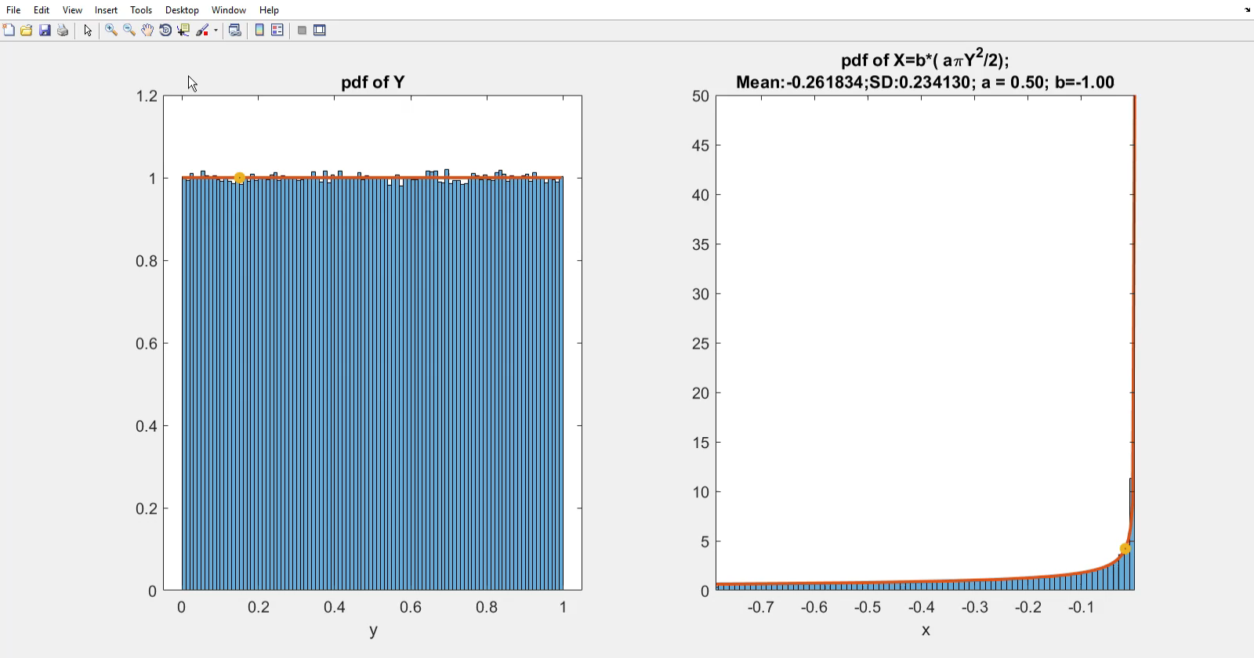
Problem 2.1. Option 1. a =0.5. b =-1.0. Play to see the animation

Slide 10
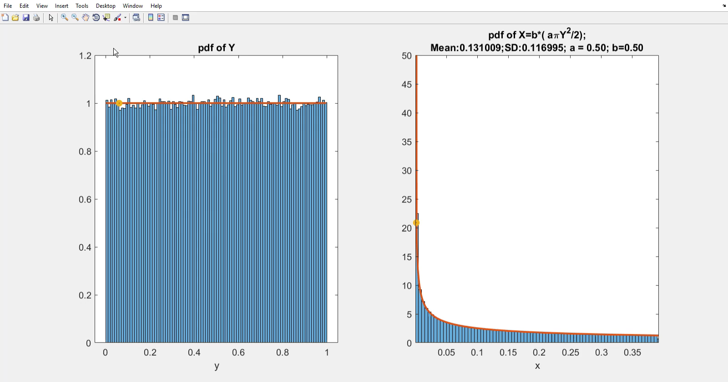
Problem 2.1. Option 1. a =0.5. b =-1.0. Play to see the animation

Slide 11
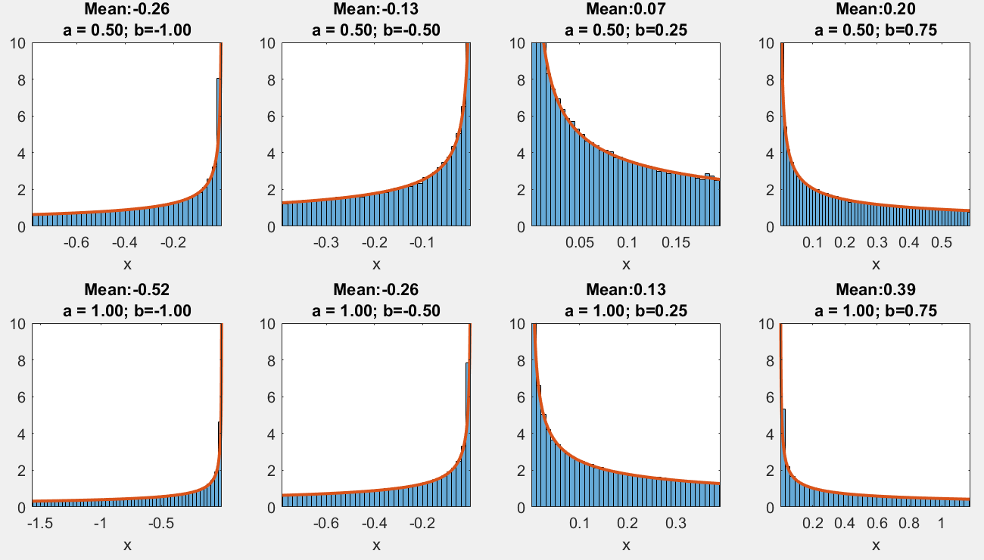
Problem 2.1. Option 2. [20%]
Show the pdf of X in a 2x4 grid. Show the mean of X, values of a and b as titles. The values of a are 0.5, and 1.0 from top to bottom. The values of b are -1.0, -0.5, 0.25, and 0.75 from left to right.

Slide 12
Problem 2.1. Marking Scheme
The items must be done correctly.
Option 1.
[1%] Draw the pdf curve of Y.
[4%] Draw the histogram in pdf of Y.
[5%] Draw the pdf curve of X.
[5%] Draw the histogram in pdf of X.
[5%] The animation of the point on the pdf curve of Y.
[5%] The animation of the point on the pdf curve of X.
[2%] The animation is repeated.
[3%] The titles of both figures.
Option 2.
[10%] There are 2x4 figures and they are correct.
[5%] The titles of the figures.
[5%] The arrangements of the figures based on a and b.

Slide 13
(50%) Problem 2.2.
There are two options.
Show student ID and name.
Then show a message to ask for option.
Option 1) Function Graph
Option 2) Fractal
Enter the option:

Slide 14
Problem 2.2. Option 1. (30%)
The following diagrams show how the inputs are computed to produce new values. Note that if the inputs are vectors, operations are performed in the array format.
h
a
x
g
x
x
g
g(x)
g
g(x,y)
k
b
y
A function accepts one parameter, x. It produces a new value g(x).
y
A function accepts two parameters, x and y. It produces a new value g(x,y). Note the parameters must be ordered correctly.
This diagram performs:
a = h(g(x)), and b = k(g(x), y).

Slide 15
Problem 2.2. Option 1.
Write a program to implement the following diagrams:
g₂₁
g₃₁
x
g₁₁
g₄₁
x
g₂₂
g₃₂
g₅₁
y
g₁₂
g₂₃
g₃₃
y
g₄₂
g₂₄
g₃₄

Slide 16
Problem 2.2. Option 1.
We denote the output computed by function g_{ij} as k_{ij}. Note the order of the inputs matters.
a
a
k_{ij}
g_{ij}
k_{ij}
g_{ij}
b
b
k_{ij =} g_{ij}(a, b)
k_{ij =} g_{ij}(b, a)

Slide 17
Problem 2.2. Option 1.
Assume that the inputs are a and b. The functions are defined as follows.
Note that you must interpret the operators properly.
Layer1 | Layer 2 | Layer 3 | Layer 4 | Layer 5
g₁₁(a,b) = a*b | g₂₁(a,b) = cos(a)/(sin²(b)+1) | g₃₁(a,b) = -(a+b)*(a-b) | g₄₁(a,b) = cos(a) - sin(b) | g₅₁(a,b) = a - b
g₁₂(a,b) = a/(|b|+1) | g₂₂(a) = a.*a | g₃₂(a,b) = sin(a + b) | g₄₂(a,b) = sin (b) - sin(a)
 | g₂₃(a,b) = sin(a) + cos(b) | g₃₃(a) = cos(a)
 | g₂₄(a) = a*sin(a) | g₃₄(a) = sin(a)

Slide 18
Problem 2.2. Option 1.
Set x in [-1.5, 1.5] and y in [-1.5, 1.5]. The step size is 0.05.
Plot each data set in F. A data set represents a mesh. Label the x-axis and the y-axis.
F = [k11; k12; k21; k23; k31; k32; k41; k42; k51];
Hint: To draw a mesh, use the followings:
s0 = index*61+1-61; % Note kij’s dimension is 61x61.
s1 = index*61+61-61;
Z = F(s0:s1,:);
C = gradient(Z);
meshz(X,Y,Z,C);
Colorbar
X and Y are produced by meshgrid.
Z contains the values for all the combinations of x and y in the grid of X and Y.

Slide 19
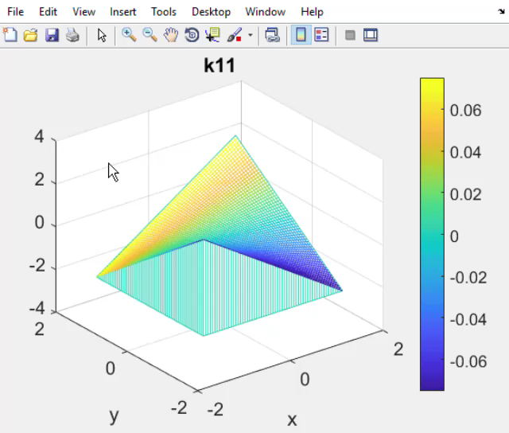
Problem 2.2. Option 1.
Play to see each item.
Press ‘m’ to view each of the items in F in a backward order.
Press ‘n’ to view each of the items in F in a forward order.
The items in F are:
F = [k11; k12; k21; k23; k31; k32; k41; k42; k51];

Slide 20
Problem 2.2. Option 1. Notice that the labels of the x-axis and y-axis shows the ranges that are the same as what we set for x and y.

Slide 21
Problem 2.2. Option 2. Importance sampling
There are two normal distributions:
Normal distribution one: (Mean, SD) = (-1,2), where SD is the standard deviation.
Normal distribution Wo: (Mean, SD) = (1.5,3)
For each normal distribution, plot a graph. And the two graphs must be shown on the same figure, one on the left side and another on the right side.
For each graph, plot the following items.
1. Compute the average, m, of random numbers under the normal distribution inside the interval [1, 8]. You must use importance sampling to compute the average. Otherwise, your score is zero.
2. Fill the region within the interval [1,8]. The color for filling the region is blue or yellow.
3. Draw the curve of the normal distribution.
4. Show the (Mean, SD), number of sample numbers, m, the area of the region as the graph title.
5. The total number of the random numbers is n = 100,000. Use axis([-5 10 0 1]).

Slide 22
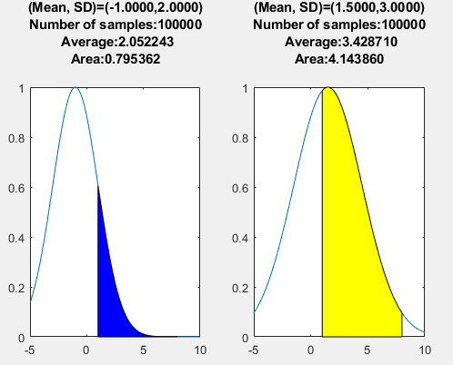
Problem 2.2. Option 2.

Slide 23
Problem 2.2. Marking Scheme
The items must be done correctly.
Option 1. (F = [k11; k12; k21; k23; k31; k32; k41; k42; k51];)
[3*9%]: Each mesh is correct; its title is correct; and the axis range is correct.
[2%]: ‘m’ and ‘n’ work well.
[1%]: Press ‘q’ to show the student ID and name. Then quit the program.
We will not modify your script. If your program does not support ‘n’ and ‘m’, your score is zero.
Option 2.
[5%] : the left curve is correct and the title is correct.
[5%]: the left region is filled correctly.
[5%]: the right curve is correct and the title is correct.
[5%] the right region is filled correctly.

Slide 24
End
Enjoy MATLAB Programming.

